Slide 1
Test plan,case,
scenario.

Slide 2
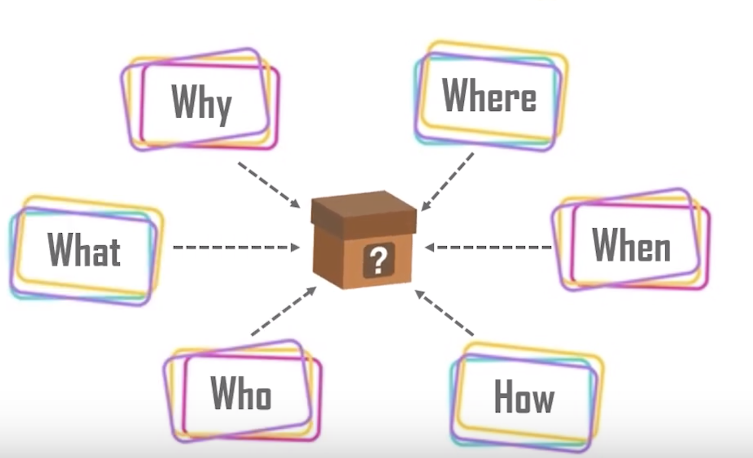
Test plan
A Software Test Plan is a document describing the testing scope, approach, resources, schedule, deliverable, communication, entry and exit criteria. It is the basis of formally testing any software/product in a project.

Slide 3
Test plans can be of different levels and types, depending upon the scope of testing.
=>Master Test Plan
=>Phase Test Plan
=>Functional Test Plan
=>Security Test Plan
=>Performance

Slide 4
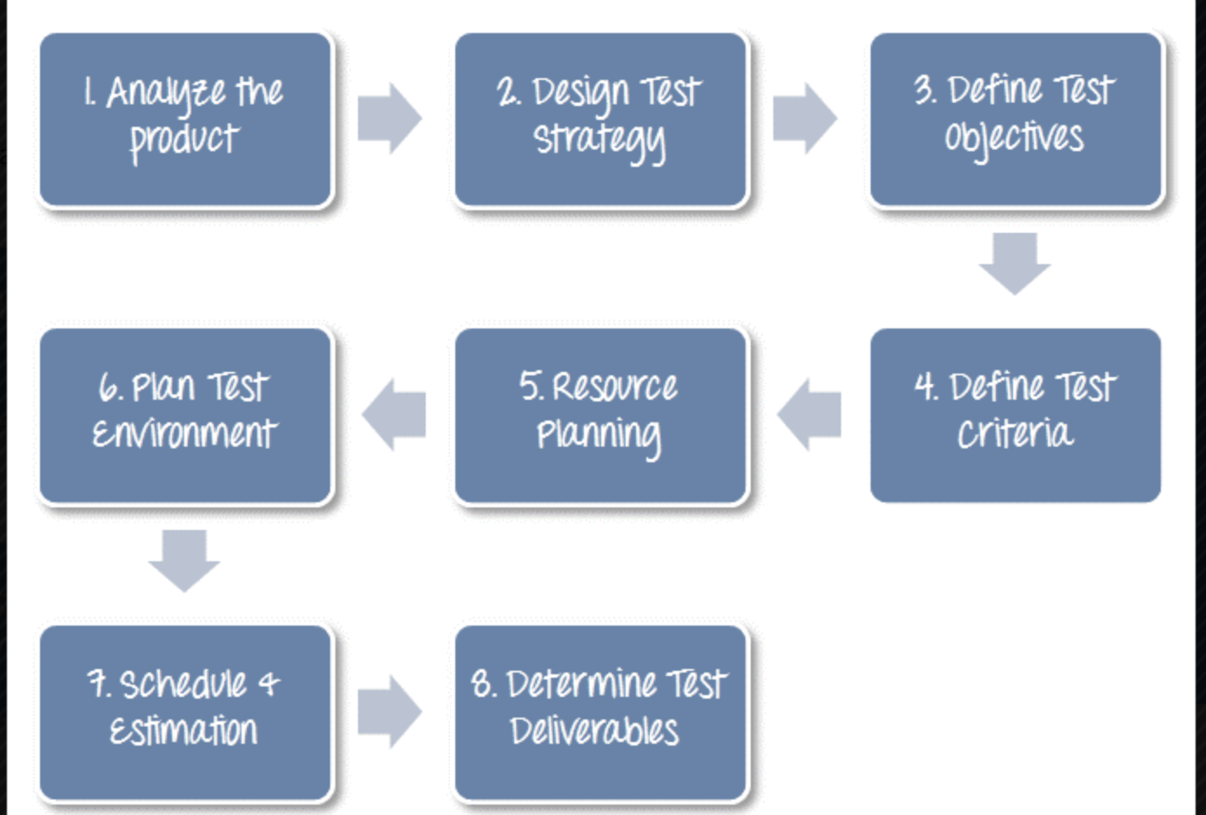

Slide 5
e
Test Plan Template
Item to Test | Test Description | Test Date | Responsibility
1.Test Plan Identifier.
2.Project description.
3.Test item.

Slide 6
4.Roles and responsibilities.
Role | Responsibility

Slide 7
5.Test Schedule.
Milestone | Deliverable | Effort(Person Hour) | Start Date | End Date

Slide 8
6.Test Plan Approval.
Signature: |  | Date:
Print Name:
Title:
Role:

Slide 9
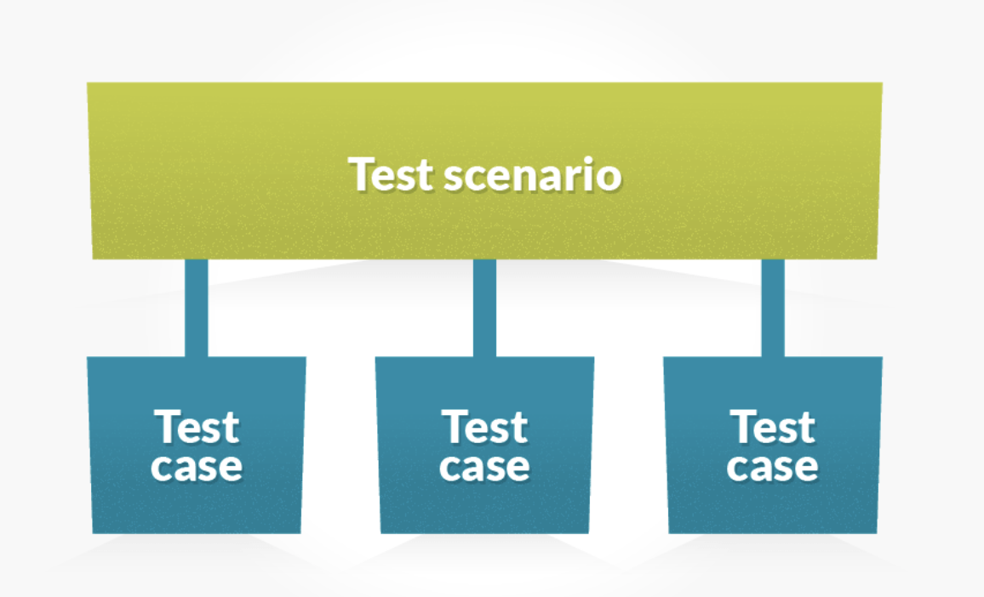
Test Scenario vs Test case.
What to be tested?
Test scenario is a collective set of test cases, sort of scenarios which determine the positive and negative aspects of the project to evaluate possible outcomes in order to identify the potential flaws in the program.
How to be tested?
A test case is a document, which has a set of test data, preconditions, expected results and postconditions, developed for a particular test scenario in order to verify compliance against a specific requirement.

Slide 10
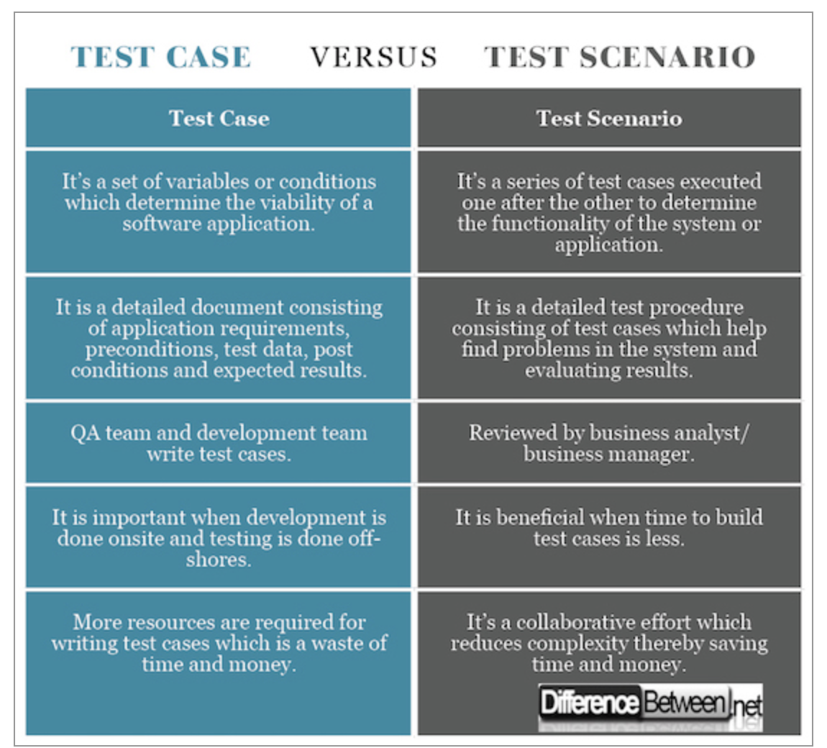

Slide 11
A test case can have the following elements:
Test Case ID
Test Case Summary
Test Procedure
Test Data
Expected Result
Actual Result
Status
Remarks
Created By
Date of Creation
Executed By
Date of Execution

Slide 12
Thank you!!!

